Slide 1
Improving Testing Through Operability

Slide 2
We’ve covered…
Runbook – operability test strategy
Logging – simple logging and adding structure for machine readability.
Alerts – determining normal with the team and showing the difference.
Hooks – control yourself and your application

Slide 3
Its all linked
Better operability improves testing
Makes testing more humane
Easier to sell to stakeholders

Slide 4
Log Rotation & Aggregation
Leverage large volumes of data safely
Early problem detection
Security
Capacity
Compliance
Improve what and how you test. With actual data!

Slide 5
Decomposability
Everything fails
Isolate the risky
Protect the important
Availability
Circuit Breakers
Mocks and stubs

Slide 6
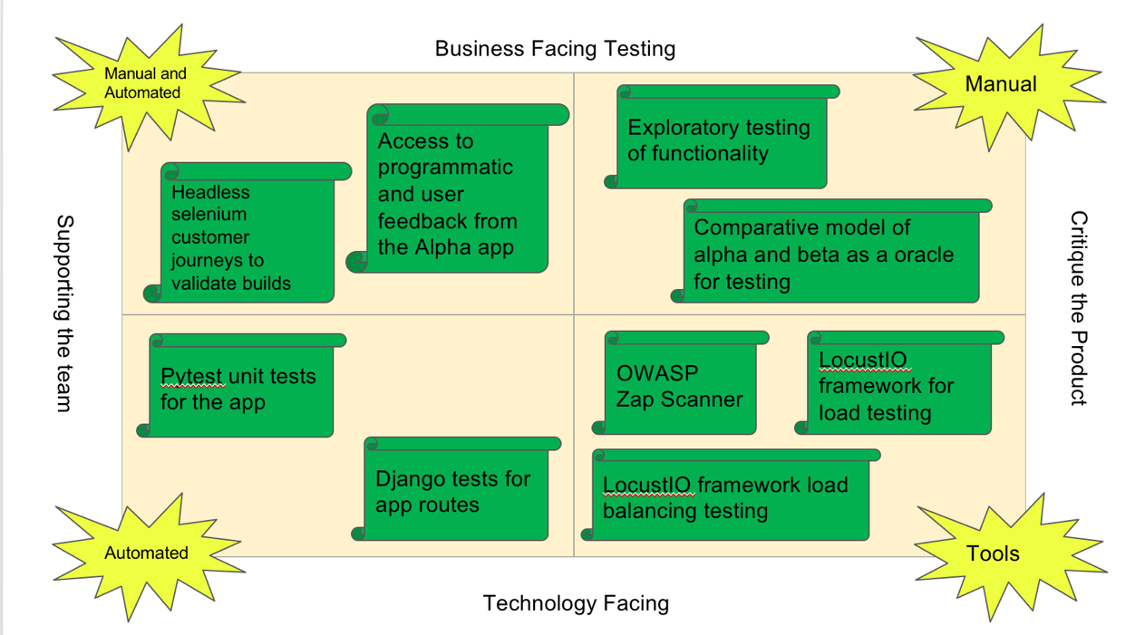
In the end, great, balanced testing!

Slide 7
And really happy ops people!

Slide 8
Thank you

